Slide 1
Portfolio Management In An Agile World
Presented by: Rick Austin

Slide 2









Rick Austin
Expert in Financial Services Industry | Georgia State Grad
ABOUT ME
Experience applying agile to small teams, large distributed teams, & change management
Information Technology Director
Agile Transition Director, Program Manager
Agile Project Management
Volunteer and Leader
Director of Development
Applications Development
Manager
WWW.LEADINGAGILE.COM FACEBOOK.COM/LEADINGAGILE LINKEDIN.COM/IN/RICKDAUSTIN
RICK@LEADINGAGILE.COM | 678.743.1616

Slide 3
Take My slides with you...
Text for Deck:
PORTFOLIO
1-844-414-9981

Slide 4
What are we Exploring
Using portfolio management so we focus on the most valuable things
How to iteratively do portfolio planning
Balancing capacity against demand

Slide 5

Portfolio Management
PMI’S DEFINITION
Portfolio management ensures that an organization can leverage its project selection and execution success. It refers to the centralized management of one or more project portfolios to achieve strategic objectives. Our research has shown that portfolio management is a way to bridge the gap between strategy and implementation.
INVESTOPEDIA’S DEFINITION
Portfolio management is the art and science of making decisions about investment mix and policy, matching investments to objectives, asset allocation for individuals and institutions, and balancing risk against performance.
Notes:
This is a definition that many of us “grew up” on for portfolio management.
The main outcome is an ability to pull strategy and implementation together.
Investopedia’s definition feel “better” for a agile/lean organization. There is an art to this but clear practices to make sure we are in alignment with strategy

Slide 6
What Is An Agile World?
Notes:
Let’s quickly create context for what I mean by agile and from there we will bring in portfolio management as it can be leveraged in an agile organization.

Slide 7
What Do I Mean?
BACKLOGS
TEAMS
WORKING TESTED product
Defines capabilities to build
Small enough for the team to develop in a day or so
Everything and everyone necessary to deliver
Meets acceptance criteria
No known defects
No unplanned technical debt

Slide 8
WHY ARE THEY IMPORTANT?
CLARITY
ACCOUNTABILITY
MEASUREABLE PROGRESS
People have clarity around what to build
People understand how it maps to the big picture
Teams can be held accountable for delivery
No indeterminate work piling up at the end of the project
Notes:
So, based on the previous slides, the way the 3 things work is by providing a framework and structure for Clarity, Accountability, and Measurable Progress within an organization.

Slide 9
HOW DOES IT SCALE?
GOVERNANCE
STRUCTURE
METRICS
Governance is the way we make economic tradeoffs in the face of constraints
They way we form teams and foster collaboration at all levels of the organization
What do we measure, how do we baseline performance and show improvement?

Slide 10
EXAMPLE 3-TIERED SYSTEM OF DELIVERY
Notes:
Here is a reference architecture we will use to discuss portfolio management

Slide 11
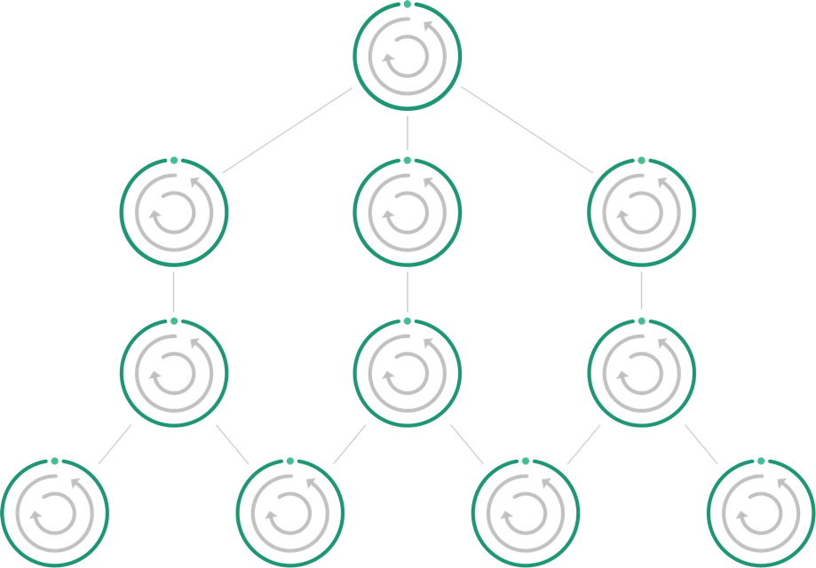
STRUCTURE
PORTFOLIO TEAMS
PROGRAM TEAMS
DELIVERY TEAMS

Slide 12
GOVERNANCE
PORTFOLIO TEAMS
Kanban
PROGRAM TEAMS
Kanban
DELIVERY TEAMS
Scrum

Slide 13
METRICS
Cycle Time
Time/Cost/Scope/Value
ROI/Capitalization
PORTFOLIO TEAMS
Kanban
PROGRAM TEAMS
Kanban
Cycle Time
Features Blocked
Rework/Defects
DELIVERY TEAMS
Scrum
Backlog Size
Velocity
Burndown
Escaped Defects
Commit %
Acceptance % Ratio
Scope Change

Slide 14
GOVERNANCE FLOW
Moving work through the system of delivery

Slide 15
Governance
Governance is the method for planning, coordinating and tracking requirements to manage the flow of work. Agile requirements are progressively elaborated from Initiatives to Epics to Features and finally Stories.
INITIATIVE
An initiative represents an actionable investment on the Investment Team to achieve a key result aligned to a strategic outcome. An initiative can span multiple portfolios and longer time horizons
EPIC
An epic represents an investment decision on the Portfolio Team, aligned with strategic intent to pursue a specific business outcome through a selected solution approach
Define the desired outcome (problem)
1-3 months
FEATURE
A feature is an improvement to, or creation of a capability developed by the Product Team, which allows or causes a user to change their behavior, contributing to a business outcome
Define what we will build (solution)
1-3 sprints
USER STORY
A user story is developed by the Delivery Team, it is a description of the user’s goal, within the context of how they interact with the features or services we create. (and 3 C’s)
Describe the user’s goals
1-3 days
Notes:
This is a typical set of things that flow through the governance model – initiatives -> epics -> features -> stories
The larger items set the context for the next smaller item

Slide 16
Governance
Organizing teams to orchestrate the delivery of business value
Portfolio Teams – The Portfolio Team exists to maximize the flow of value through the organization by managing the throughput and value density and ensuring a focus on achieving business outcomes.
Portfolio Team
Product Teams – Product Teams' purpose is to balance demand with capacity and select and adapt approaches as assumptions are evaluated. They also serve as the conduit between strategy alignment (Portfolio Team) and strategy performance (Delivery Team).
product Team
product Team
product Team
Delivery Teams – The Delivery Team establishes the foundation for predictably implementing solutions aligned to strategic value, and they allow us to leverage fast feedback cycles to evaluate assumptions and optimize learning.
DELIVERY Team
DELIVERY Team
DELIVERY Team
DELIVERY Team
DELIVERY Team
DELIVERY Team
Notes:
Many ​delivery teams can’t operate autonomously because the necessary conditions don’t exist. It requires continuous planning and orchestration to ensure delivery teams are never starved, never blocked, and always working on the next most valuable thing
There is no agility without the ability to form teams, build backlogs, and produce a Working Tested Product increment at the end of some predetermined time period.

Slide 17
Enterprise Delivery Approach
Optimize Flow and the Time to Business Value at Scale
PORTFOLIO TEAM
Portfolio alignment
Portfolio Prioritization
Solution Definition
Release Targeting
In progress
Epic
validation
Completed
Epic | Kanban
Strategic Alignment
Solution Vision
Demand Planning
Execution
validation
MEASURE EFFECTIVENESS
Product
Team
Intake
Solution Design
Release Planning
Feature
Ready
In progress
Feature validation
Feature Completed
Feature | Kanban
Demand Planning
Execution & Accountability
Delivery
TEAM
Make Ready
Story Ready
In progress
Story Done
Story Accepted
Story | Scrum
Notes:
This is an overall view of the flow of work – epics at the portfolio level, features at the product level, and stories at the delivery team level

Slide 18
Portfolio Team

Slide 19
Foundational team roles
The Portfolio Team, a cross-functional team of leaders
PRODUCT MANAGER
The role of the Portfolio Team is to maximize the flow of value through the organization by managing the throughput and value density, ensuring a focus on the achievement of business outcomes.
STRATEGIC PRODUCT DESIGNER
PORTFOLIO ORCHESTRATOR
SOLUTION ARCHITECT
Notes:
Here are a set of roles that you may find on a portfolio management team. Your mileage may vary depending upon the size and complexity of your organization.
Role names may be different as well but the function of this team will be the same.

Slide 20
Portfolio Team Role Descriptions
ROLE |  | DESCRIPTION
PRODUCT MANAGER |  | Collaborates to establish product vision and identify new customer opportunity; ensures the solutions are valuable and successful; facilitates communication and relationships between Product Owners and technology; prioritizes and manages work intake​.​
PORTFOLIO ORCHESTRATOR |  | Ensures the Portfolio Team has clarity of capacity and demand; provides oversight to maximize governing the flow of value; ensures portfolio decisions are in alignment with the strategy, budgets and financial guidelines; acts as the escalation point for delivery issues or de-conflicting dependencies that affect multiple teams that need resolution by the Portfolio Team.
Solution ARCHITECT |  | Designs the way products are used together in solving business problems and applies proven enterprise integration patterns and domain solutions to preserve digital threads; ensures that architecture is consistent across the portfolio; ensures standards exist for infrastructure, development, and testing
STRATEGIC PRODUCT DESIGNER |  | Optional as needed. Creates the strategy to align the product vision for the user experience; ensures the solutions are usable​.​
Notes:
Just a bit more detail on each role. I’ll not dig into these for now and wanted to provide this as a reference.

Slide 21
Portfolio tier
Capabilities of the Portfolio Team
Portfolio alignment
Portfolio Prioritization
Solution Definition
Release
targeting
In progress
Epic validation
Epic
Completed
Strategic Alignment
Solution Vision
Clarity and Capacity
Execution
Measure effectiveness
CONSIDER OPTIONS
DEFINE THE WORK
IDENTIFY RISKS
VALIDATE SOLUTION TO BUSINESS INTENT
BALANCE DEMAND & CAPACITY
REDUCE TIME TO VALUE
PLAN FOR DEPENDENCIES
AVOID REWORK
MANAGE FLOW
GUIDE DELIVERY
MINIMIZE RISKS
VALIDATE SOLUTION MEETS SUCCESS CRITERIA
MEASURE EFFECTIVENESS
VALIDATE CAPABILITY
VALIDATE SUCCESS CRITERIA
DEFINE WHAT IS NEEDED
Prioritize value
MAXIMIZE PERFORMANCE OF Capabilities

Slide 22
Portfolio Team CADENCE
(Monthly)
Develop a shared understanding of priorities, tradeoffs, options for Epic Intake, solution approach, and Release Targeting Timeframe
(Quarterly)
Review performance data and analysis​, improve assumptions, modify/update Epics and roadmap
INTAKE AND DEMAND PLANNING
PROGRESS REVIEW
BENEFIT REALIZATION
PORTFOLIO RETROSPECTIVE
(Bi-Weekly)
”Walk the Kanban” to understand the progress of Epics and child Features, dependencies and risks
(Quarterly)
Review how the delivery system is working and plan improvements

Slide 23
Portfolio Governance

Slide 24
Strategic Alignment
PORTFOLIO TEAM
Portfolio alignment
Portfolio Prioritization
Solution Definition
Release Targeting
In progress
Epic
validation
Completed
Epic | Kanban
Strategic Alignment
Solution Vision
Demand Planning
Execution
validation
MEASURE EFFECTIVENESS
What demand is flowing in? Is it balanced against the desired capacity mix?
Does this fit in to an existing product area?
Do we have a Product Owner clearly identified for this?
Do we have priority (WSJF) assigned to this?
Do we have a product team with the knowledge & skills to build this capability?
Product
Team
Intake
Solution Design
Release Planning
Feature
Ready
In progress
Feature validation
Feature Completed
Feature | Kanban
Demand Planning
Execution & Accountability
Delivery
TEAM
Make Ready
Story Ready
In progress
Story Done
Story Accepted
Story | Scrum
Notes:
This is all about making sure thing coming into the portfolio could continue to move forward. Each step will test for things which allows us to make continue, kill, revise decisions. This first step is mostly deciding if the item is in alignment with our goals. Compliance?
Do we clearly understand the business goals or benefits?
Use the online bill payment example I’ve used in the past – increase subscriptions for people in a certain age group

Slide 25
Solutioning
PORTFOLIO TEAM
Portfolio alignment
Portfolio Prioritization
Solution Definition
Release Targeting
In progress
Epic
validation
Completed
Epic | Kanban
Strategic Alignment
Solution Vision
Demand Planning
Execution
validation
MEASURE EFFECTIVENESS
Who do we need to engage to decompose epic/subepic into more thinly-sliced, valuable chunks?
Who helps understand UX, technical approach, business and market viability (MVP)?
What uncertainty do we need to drive down early?
How can we be more specific about value delivery?
What are our options for implementation?
Product
Team
Intake
Solution Design
Release Planning
Feature
Ready
In progress
Feature validation
Feature Completed
Feature | Kanban
Demand Planning
Execution & Accountability
Delivery
TEAM
Make Ready
Story Ready
In progress
Story Done
Story Accepted
Story | Scrum
Notes:
Here we are putting focus on viability of creating a solution. Do we know how we intend to deliver the solution?
Compliance

Slide 26
Demand Planning
PORTFOLIO TEAM
Portfolio alignment
Portfolio Prioritization
Solution Definition
Release Targeting
In progress
Epic
validation
Completed
Epic | Kanban
Strategic Alignment
Solution Vision
Demand Planning
Execution
validation
MEASURE EFFECTIVENESS
Validate that the proposed solution delivers against the envisioned value
Dependencies are understood and defined
Right sized to enter system of delivery
Are the epics sufficiently elaborated into valuable features
Is work sequenced properly based on dependencies?
Work with product teams to target timeframe for release to execute
When is capacity coming available?
Product
Team
Intake
Solution Design
Release Planning
Feature
Ready
In progress
Feature validation
Feature Completed
Feature | Kanban
Demand Planning
Execution & Accountability
Delivery
TEAM
Make Ready
Story Ready
In progress
Story Done
Story Accepted
Story | Scrum
Notes:
We are now putting effort into creating a credible plan, one that considers capacity, dependencies, risks…

Slide 27
Execution
PORTFOLIO TEAM
Portfolio alignment
Portfolio Prioritization
Solution Definition
Release Targeting
In progress
Epic
validation
Completed
Epic | Kanban
Strategic Alignment
Solution Vision
Demand Planning
Execution
validation
MEASURE EFFECTIVENESS
Are we managing and mitigating risks proactively?
Are there any impediments preventing us from meeting our commitments/ plan?
What are the differences from the proposed plan? More complexity? Capacity?
Are we operating over capacity? Do we need to pull work back?
Product
Team
Intake
Solution Design
Release Planning
Feature
Ready
In progress
Feature validation
Feature Completed
Feature | Kanban
Demand Planning
Execution & Accountability
Delivery
TEAM
Make Ready
Story Ready
In progress
Story Done
Story Accepted
Story | Scrum
Notes:
Are we staying on track with our plans? Are we learning something as we deliver and gain feedback? Are we dealing with impediments?
The portfolio team is an escalation point for any execution challenges

Slide 28
Measure Effectiveness
PORTFOLIO TEAM
Portfolio alignment
Portfolio Prioritization
Solution Definition
Release Targeting
In progress
Epic
validation
Completed
Epic | Kanban
Strategic Alignment
Solution Vision
Demand Planning
Execution
validation
MEASURE EFFECTIVENESS
Is this in prod environment?
Does this meet acceptance criteria and strategic objectives?
Can we measure value/get feedback?
Released any dependent work?
Definition of Done met?
Product
Team
Intake
Solution Design
Release Planning
Feature
Ready
In progress
Feature validation
Feature Completed
Feature | Kanban
Demand Planning
Execution & Accountability
Delivery
TEAM
Make Ready
Story Ready
In progress
Story Done
Story Accepted
Story | Scrum
Notes:
It is critical to be able to evaluate the success of what was delivered. Did we see the business benefits we expected?
Use the example of online bill payments for people in a certain age.

Slide 29
Ineffective Collaboration?
PORTFOLIO TEAM
Portfolio alignment
Portfolio Prioritization
Solution Definition
Release Targeting
In progress
Epic
validation
Completed
Epic | Kanban
Strategic Alignment
Solution Vision
Demand Planning
Execution
validation
MEASURE EFFECTIVENESS
If the proper amount of collaboration and alignment between Portfolio and Product Teams do not exist, then Product Teams:
Waste capacity on work that may not be the most valuable
Lose clarity on the next most important things to work on
Get blocked or starved and may pick up poorly defined work too early
Spend time scoping and planning work that may not move forward
Learn about dependencies and risks much later
Product
Team
Intake
Solution Design
Release Planning
Feature
Ready
In progress
Feature validation
Feature Completed
Feature | Kanban
Notes:
When the portfolio tier does not engage or collaborate well with the product teams then you may see these types of failures.

Slide 30
Prioritization Techniques

Slide 31


Cost of Delay
If you only measure one thing, measure cost of delay.
—D. Reinertsen, The Principles of Product Development Flow
COST OF DELAY:
The value that could be earned each month a project is in the market
It is a way of communicating the impact of time on desired outcomes

Slide 32
What is WSJF?
An expression of business value
Does the value decay over time?
Does it reduce risks or create future opportunities?
USER BUSINESS VALUE
TIME CRITICALITY
RISK REDUCTION /OPPORTUNITY ENABLEMENT VALUE
+
+
WSJF
=
JOB SIZE
How long will it take to deliver?

Slide 33
Compare Features
3 Features of a certain value with a CD3 calculation (value / duration)
Total amount of value across three features is $19,000
FEATURE | DURATION | VALUE | CD3
A | 3 weeks | $3,000 | 1
B | 4 weeks | $7,000 | 1.75
C | 6 weeks | $9,000 | 1.5
Note: Values often are expressed using a relative scale (e.g., Fibonacci)

Slide 34
Priority Impact on Cost of Delay
TOTAL COST OF DELAY
$247K
$175K
$187K
$157K
SHORTEST JOB FIRST
MOST VALUABLE FIRST
DO BASED ON HIGHEST CD3
NO PRIORITY
Week | 1 | 2 | 3 | 4 | 5 | 6 | 7 | 8 | 9 | 10 | 11 | 12 | 13 | 14
No Priority | - | - | - | - | - | - | - | - | - | - | - | - | - | $19,000
Shortest Job First | Feature A–$3,000 |  |  | Feature B–$7,000 |  |  |  | Feature C–$9,000 |  |  |  |  |  | $19,000
Most Valuable First | Feature C–$9,000 |  |  |  |  |  | Feature B–$7,000 |  |  |  | Feature A–$3,000 |  |  | $19,000
Highest CD3 | Feature B–$7,000 |  |  |  | Feature C-$9,000 |  |  |  |  |  | Feature A–$3,000 |  |  | $19,000

Slide 35
Demand Management
How We Might Express Capacity
Notes:
How do you think about capacity when planning for how much you can commit to delivering?

Slide 36
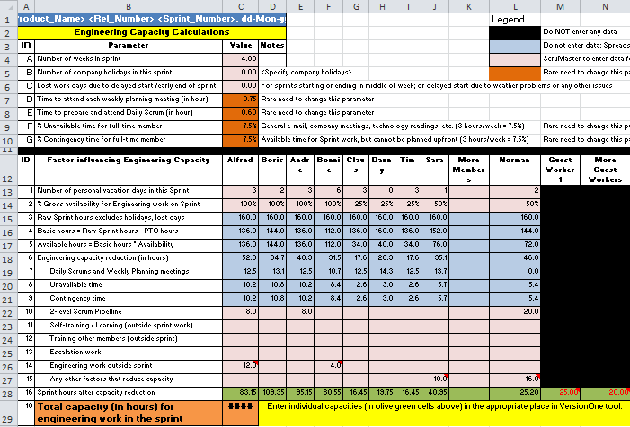
How TO Express Capacity?

Slide 37
“Capacity” can be expressed as …
“TEAM MONTHS”
“Only 25% of the “Team Months” for Team X remain for FY17”
e.g., 3 months remaining of 12 months this year
“TEAM SPRINTS”
“There are 6.5 “Team Sprints” for Team X remaining for FY17”
e.g., 13 weeks / 2 weeks per sprint
“TEAM RELEASES”
“There are 2.25 “Team Releases” for Team X remaining for FY17”
e.g., 13 weeks / 3 Sprints per Release
STORY POINTS
“There are 150 Story Points available for the remainder of the year”
e.g., Average velocity of 25 SPs x 6.5 Sprints remaining

Slide 38

Stable Velocity is Required!
“TEAM MONTHS”
“Only 25% of the “Team Months” for Team X remain for FY17”
e.g. 3 months remaining of 12 months this year
…Meaningless without Stable Velocity
“TEAM SPRINTS”
“There are 6.5 “Team Sprints” for Team X remaining for FY17”
e.g. 13 weeks / 2 weeks per sprint
“TEAM RELEASES”
“There are 2.25 “Team Releases” for Team X remaining for FY17”
e.g. 13 weeks / 3 Sprints per Release
“There are 150 Story Points available for the remainder of the year …”
STORY POINTS
DELIVERY TEAM
e.g. Average velocity of 25 SPs x 6.5 Sprints remaining

Slide 39
Capacity is invested to obtain outcomes
10 MONTHS
INVESTMENT THEMES
20% ~ 10 TEAM MONTHS
20% ~ 10 TEAM MONTHS
35% ~ 17.5 TEAM MONTHS
Early on you can “roadmap” out what you’re willing to invest capacity for across investment themes …
25% ~ 12.5 TEAM MONTHS
Program Capacity Over Next 10 Months = 50 Team Months
Notes:
Example investment themes:
Customer acquisition
Technical debt
Operational

Slide 40
Planning & road-mapping
Rolling Wave Planning and Roadmap Prioritization

Slide 41
Portfolio Planning
Planning Horizon
Deliverables associated with each planning level — Strategy to the Scrum teams
STRATEGY
12-24 month
Strategy Council provides Strategic Roadmap derived from Group long term and short term strategies
Strategy Statement
Strategic Initiative budget allocation
PORTFOLIO
6-12 month
Based on the Strategic Initiative budget allocation and the priority of the Programs
Portfolio Roadmap
Portfolio budget allocation
Portfolio Priorities
PRODUCT
2-6 month
Based on the Platform and Product budget allocation and the business priorities
Product Roadmap
Product budget allocation
Product Priorities
RELEASE
2-6 month
Sequencing delivery of Epics, Features, Stories based on business priority
Epic Priorities
Epic and Feature Sequencing
Delivery Team assignment
ITERATION
Delivery Team commitments for Stories in the next Iteration
Story Sequencing
Delivery Team commitment
1-4 sprint
TASK
One sprint
Delivery Team delineates stories into tasks, and assigns tasks to team members
Task Definition
Delivery Team member commitment
HORIZON
DESCRIPTION
DELIVERABLE
Notes:
This planning “onion” represents different levels of planning from strategic al the way down to the planned work by delivery teams

Slide 42
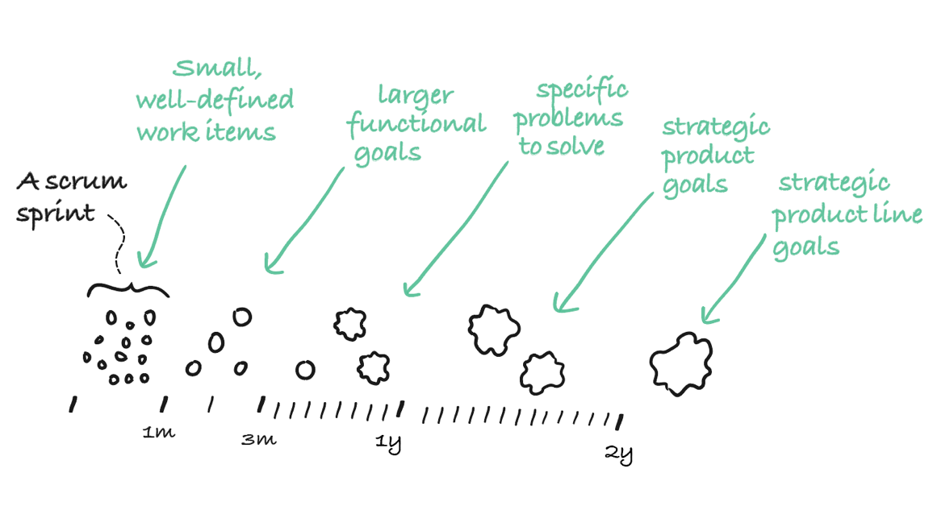
Agile Uses Rolling Wave Planning
Rolling Wave Planning, used in Agile processes, embraces the Lean ideal of making decisions at the last responsible moment, when the most possible information is available. This maximizes flexibility and planning accuracy.
Notes:
We have a lot more detail for things farther out.
Is it a good idea to have details for things we’re doing 12+ months from now?

Slide 43
Rolling Wave Planning
Define a Planning Horizon for Sprint, Product, and Portfolio
Month 1
Month 2
Month 3
Month 4
Month 5
Month 6
Month 7
Month 8
Month 9
Month 10
Month 11
Month 12
Sprint Horizon
Planning Horizon is 1-2 months based on Defined story backlog
Story point estimated for 1-2 months
Release 1
Release 2
Month 1
Month 2
Month 3
Month 4
Month 5
Month 6
Month 7
Month 8
Month 9
Month 10
Month 11
Month 12
Product Horizon
Planning Horizon is 1-6 months
Includes 1-2 month Sprint Plan
Feature level estimates for Epics for months 3-4-5-6
Release 1
Release 2
Release 3
Release 4
Month 1
Month 2
Month 3
Month 4
Month 5
Month 6
Month 7
Month 8
Month 9
Month 10
Month 11
Month 12
Portfolio Horizon
Planning Horizon is 1-12 months
Includes 1-6 month Release Plan
Epic Level estimated for months 7-12
Notes:
This represents possible planning horizons that you may consider. Of course, your organization may have other needs

Slide 44
Rolling Wave Planning
Choose a Method for Rolling Wave Planning
Monthly / Quarterly Release Planning
Progressive Elaboration of Epics to Features to Stories to Tasks
Recurring scheduled Agile ceremonies for Progressive Elaboration
Product Teams decompose Epics in Feature and Story Mapping sessions
Product and/or Scrum teams Groom Stories and define Story Tasks
For each Epic define the Risks, Dependencies and Estimates
Epics, Features, Stories are sequenced and appended to the plan Monthly or Quarterly
High
Backlog
Variability

Slide 45
Rolling Wave Planning
Choose a Method for Rolling Wave Planning
Continuous Flow
Progressive Elaboration of Epics to Features to Stories to Tasks
Recurring scheduled Agile ceremonies for Progressive Elaboration
Product Teams decompose Epics in Feature and Story Mapping sessions
Product and/or Scrum teams Groom Stories and define Story Tasks
For each Epic define the Risks, Dependencies and Estimates
Epics, Features, Stories are sequenced and appended to the plan Continuously
Low
Backlog
Variability

Slide 46
Build the Plan

Slide 47
Build the Plan
Make Ready for Portfolio Planning
Release 1
Release 2
Release 3
Release 4
Month 1
Month 2
Month 3
Month 4
Month 5
Month 6
Month 7
Month 8
Month 9
Month 10
Month 11
Month 12
Epic to Feature
Epic Canvas decomposition to Epic(s)
Epic Brief for Epic definition and Feature naming
Epic Brief with named Features
Epic estimation (Team Sprint Cost)
Build backlog of Epics at Portfolio horizon
Plan to a defined ratio of known, predictable team Story Point Velocity attainment
Adjust commensurate to confidence in Feature estimates (Plan to 80% Velocity)
Product
Leadership
initiative
Solution definition
Release targeting
Product
Owner
Epic
Solution design
Release planning
Delivery
Team
Story
Story make ready
Story ready

Slide 48
Build the Plan
Make Ready for Release Targeting
Release 1
Release 2
Month 1
Month 2
Month 3
Month 4
Month 5
Month 6
Month 7
Month 8
Month 9
Month 10
Month 11
Month 12
Epic to Feature
Epic Canvas decomposition to Epic(s)
Epic Brief for Epic definition and Feature naming
Feature/Story mapping with rapid estimation
Feature estimation (Team Sprint Cost)
Build backlog for Release Planning horizon
Plan to a defined ratio of known, predictable team Story Point Velocity attainment
Adjust commensurate to confidence in Feature estimates (80% Velocity)
Product
Leadership
initiative
Solution definition
Release targeting
Product
Owner
Epic
Solution design
Release planning
Delivery
Team
Story
Story make ready
Story ready

Slide 49
Build the Plan
Make Ready for Sprint Planning
Sprint 1
Sprint 2
Sprint 3
Sprint 4
Month 1
Month 2
Month 3
Month 4
Month 5
Month 6
Month 7
Month 8
Month 9
Month 10
Month 11
Month 12
Epic to Feature to Story to Task
Epic Canvas decomposition to Epic(s)
Epic Brief for Epic definition and Feature naming
Feature/Story mapping for Feature and Story definition
Story refinement
Story Tasking and hours prior to or during Spring Planning session
Build 3-4 Sprints of Backlog for each Scrum team
Plan to known, predictable team Story Point Velocity
Product
Leadership
initiative
Solution definition
Release targeting
Product
Owner
Epic
Solution design
Release planning
Delivery
Team
Story
Story make ready
Story ready

Slide 50
Sustain the Plan
Month 1
Month 2
Month 3
Month 4
Month 5
Month 6
Month 7
Month 8
Month 9
Month 10
Month 11
Month 12
Month 13
Each Month
The Delivery Teams will complete sprints and deliver Stories
The Delivery Team and Product Team will elaborate Stories to sustain the Sprint backlog
Month 1
Month 2
Month 3
Month 4
Month 5
Month 6
Month 7
Month 8
Month 9
Month 10
Month 11
Month 12
Month 13
Each Month
The Product team will Perform Feature definition and Story Mapping to sustain the Release Planning horizon
Month 1
Month 2
Month 3
Month 4
Month 5
Month 6
Month 7
Month 8
Month 9
Month 10
Month 11
Month 12
Month 13
Each Month
The Portfolio Team will Perform Epic definition to sustain the Portfolio horizon

Slide 51
Rick Austin
Expert in Financial Services Industry | Georgia State Grad
ABOUT ME
Experience applying agile to small teams, large distributed teams, & change management
Information Technology Director
Agile Transition Director, Program Manager
Agile Project Management
Volunteer and Leader
Director of Development
Applications Development
Manager
WWW.LEADINGAGILE.COM FACEBOOK.COM/LEADINGAGILE LINKEDIN.COM/IN/RICKDAUSTIN
RICK@LEADINGAGILE.COM | 678.743.1616

Slide 52
Take My slides with you...
Text for Deck:
PORTFOLIO
1-844-414-9981

Slide 53
Appendix

Slide 54
Portfolio tier
Portfolio Team — Purpose, Activities, Exit Policies
Portfolio Alignment
Portfolio Prioritization
Solution Definition
Release Targeting
In PROGRESS
EPIC Validation
Completed
 | STRATEGIC ALIGNMENT |  | SOLUTION VISION | DEMAND PLANNING | EXECUTION | VALIDATION | MEASURE EFFECTIVENESS
Purpose | Define what is needed Maximize Performance of Capabilities | Prioritize for Value Validate Business Intent | Consider Options Identify Risks Validate Solution meets Business Intent | Balance capacity & demand Reduce Time to Value Identify & plan for dependencies Avoid Rework | Manage Flow Guide Delivery Minimize Risks | Validate solution meets Success Criteria | Measure Effectiveness Validate Capability Validate Success Criteria
Activities | Intake Initiatives / Epics Validate alignment to Strategic Objectives (Business and Product) Ensure alignment to Business Capabilities Define Success Criteria Defer Epics that are clearly not aligned to strategy | OOM relative estimates for value and effort using Rapid Estimation techniques Validate Epic (Brief) Vision & Constraints Epic Prioritization | Product Discovery Features Identified (Named) Epic MVP Right Size Epics (Slice) Identify work to address Constraints, Risks & Dependencies Conduct Technical Impact Assessment | Determine Capacity Plan for Risks & Dependencies Sequence Work based on Priority and Constraints | Review Epic Health & Portfolio Dashboard Monitor & communicate Release Health to Stakeholders Manage flow to optimize time to value Continue, Change or Stop Decisions | Feature Demos User Acceptance Testing Epic Validation Exit Policies met Epic Implementation Continue, Change or Stop Decisions | Epic Retrospectives Measure Outcomes Validate estimated and actual Benefits realized as a result of the Epics / Initiatives Update the Capability Model
Exit Policies | Epic Definition (Brief) Description, Problem Clarity complete Strategically aligned Epics Created in Portfolio Backlog | Epic Definition (Brief) Solution: Approach , Constraints complete Prioritized Epic Backlog for the Portfolio Initial Priority Score (WSJF) | Epic Definition (Brief) Solution Approach, Constraints (Risks, Dependencies), Features (Named) Updated Effort / Cost Estimate Lightweight Business Case Updated Priority Score (WSJF) Technology Impact Assessment Epic Definition of Ready Validated Portfolio Roadmap Updated | Epics Scheduled to Completion Backlog for Defined Planning Horizon Sequenced Portfolio Roadmap Product Backlog Updated Updated Risk Assessment Release Plan Accepted | Portfolio Dashboard Epic Dashboard Product Dashboard Risk Dashboard WIP Limits Monitored Team Metrics and Assessment Dashboards | Epic Definition of Done Validated Epics Delivered and Stakeholder has Accepted | Benefits Realization Review Feedback to Improve other Epic estimates of Value, Effort and Priority Capability Performance Analysis Update Retrospective Analysis KPIs updated to include Epic Success Criteria Epic is Completed
RACI (Team) | R – Portfolio Team, Product Management A - Portfolio Team C - Product Team I – Delivery Team | R - Portfolio Team, Product Management A - Portfolio Team C - Product Team I – Delivery Team | R – Portfolio Team, Product Team A - Portfolio Team C – Product Management I – Delivery Team | R – Portfolio Team, Product Team A - Portfolio Team C – Product Management I – Delivery Team | R – Portfolio Team, Product Team A - Portfolio Team C – Product Management I – Delivery Team | R – Portfolio Team, Product Team A - Portfolio Team C – Product Management I – Delivery Team | R – Portfolio Team, Product Team A - Portfolio Team C – Product Management I – Delivery Team

Slide 55
PRoduct tier
Product Team – Purpose, Activities, Exit Policies
Intake
Solution Design
Release Planning
Feature Ready
In PROGRESS
Feature Validation
Feature Completed
 | STRATEGIC ALIGNMENT | SOLUTION VISION | DEMAND PLANNING |  | EXECUTION | VALIDATION | MEASURE EFFECTIVENESS
Purpose | Intake process for Epics to be considered | High level solution design Validate solution viability | Elaborate stories from features Identify risks & dependencies | Features are ready for development Credible plan exists MMF identified | Assess and guide the progress of value delivery Review Team Performance | All features and stories are done for the Epic | Feature Complete
Activities | Intake Epics Validate Epic Definition (Brief) meets Definition of Ready | Technology Impact Assessment Identify solution options Identify work to address risks and dependencies Right Size Features (Slice) | Story mapping Right Size Features (Slice) Estimate Features Plan Risks & Dependencies Define Test Plans | Validate MMF for Epic Make release commitment Refine Feature Estimates Refine Story Estimates Feature Backlog Planning | Review Epic Health & Portfolio Dashboard Monitor & communicate Release Health to Stakeholders Continue, Change or Stop Decisions | Deployment to Testing environments Acceptance Criteria Testing Capability Validation Defect remediation NFR Validation Continue, Change or Stop Decisions | Operational handoff Warranty support Measure Outcomes
Exit Policies | Epic Definition (Brief) meets Definition of Ready Product Backlog Updated | Feature Definition Named Stories Architecture Impact Assessment Risk and Dependency Assessment Test Strategy Defined UX Design High Level Design Feature Cost Estimate Product Backlog Updated | Sequence Work based on Priority and Constraints Release Plan Updated risk and dependency lists Stories Named Spikes identified Validation and Integration Plan | Features Scheduled to Completion Backlog for Defined Planning Horizon Product Backlog Updated Feature Definition of Ready Validated | Portfolio Dashboard Epic Dashboard Product Dashboard Release Burnup Risk Dashboard WIP Limits Monitored Team Metrics and Assessment Dashboards Sprint Burndown | Feature Acceptance Criteria Validated Feature Validation Exit Policies met Updated documentation Testing Approved Support Manual Updated Service/Operational Level Agreement Updated | Features deployed to production Release criteria met No high severity defects Feature is completed KPIs reflect Feature Outcomes
RACI (Team) | R – Product Team, Delivery Team A - Product Team C - Delivery Team I – Portfolio Team | R – Product Team, Delivery Team A - Product Team C - Delivery Team I – Portfolio Team | R – Product Team, Delivery Team A – Product Team C- Delivery Team I – Portfolio Team | R – Product Team, Delivery Team A – Product Team C - Delivery Team I – Portfolio Team | R – Product Team, Delivery Team A - Product Team C - Delivery Team I – Portfolio Team | R – Product Team, Delivery Team A – Product Team C - Delivery Team I – Portfolio Team | R – Product Team, Delivery Team A – Product Team C - Delivery Team I – Portfolio Team

Slide 56
Delivery tier
Delivery Team — Purpose, Activities, Exit Policies
Make Ready
Story Ready
In PROGRESS
Story Done
Story Accepted
 | DEMAND PLANNING |  | EXECTION AND ACCOUNTABILITY
Purpose | Ready the backlog | Stories ready for Delivery Teams | Work is done to complete story / feature Review Team Performance | Story has been completed | Story / feature has been accepted
Activities | Create story in defined format Create acceptance criteria in the defined format (GWT) Provide additional documentation as needed Right Size Stories (Slice) | Story acceptance criteria is derived from feature acceptance criteria Revise Level of Value Create story tasks | Develop story functionality Test functionality Code/Peer Review Technical debt remediation Defect remediation | Story meets the definition of done Stakeholder approves story based on acceptance criteria. Bugs found for the story have been remediated | Ongoing Support Operational Handoff Lessons Learned
Exit Policies | Defined User Story Acceptance Criteria is complete Architecture Artifacts UX Design, Wireframe Artifacts Story Point Estimate | Backlog for Defined Planning Horizon Story Definition of Ready Validated Tasks Defined Task Hours Estimate Iteration Planning | Monitor Progress on Scrum Board Standup Story Development Story Testing Sprint Burndown Team Metrics and Assessment Dashboards | Story Done Story Definition of Done Validated Story Demo | Operational documentation updated (as needed) Sprint Retrospective Delivery Team Metrics Story is Accepted by Stakeholder
RACI (Team) | R – Delivery Team, Product Team A – Delivery Team C – Product Team I – Portfolio Team | R – Delivery Team, Product Team A – Delivery Team C – Product Team I – Portfolio Team | R – Delivery Team A – Delivery Team C – Product Team I – Portfolio Team | R – Delivery Team, Product Team A – Delivery Team C – Product Team I – Portfolio Team | R – Delivery Team, Product Team A – Delivery Team C – Product Team I – Portfolio Team

Slide 57
Epic Brief
DESCRIPTION
Name
Epic Owner/ Product Manager
VISION
Value Statement
Features/Benefits
CONSTRAINTS
Dependencies
PLANNING
Investment Theme (and Capability if known)
Personas
Risks
Release Planning
Opportunity Case
Roadmap
Assumptions
Epic Owner completes the description section
Epic Owner completes the value statement
Portfolio Team validates alignment to strategy

Slide 58

Additional Resources
Cost of Delay https://www.leadingagile.com/2017/06/cost-delay-project-management-2/
Lean Portfolio Management Podcast https://www.leadingagile.com/podcast/lean-portfolio-management-w-tina-wang/

